Slide 1
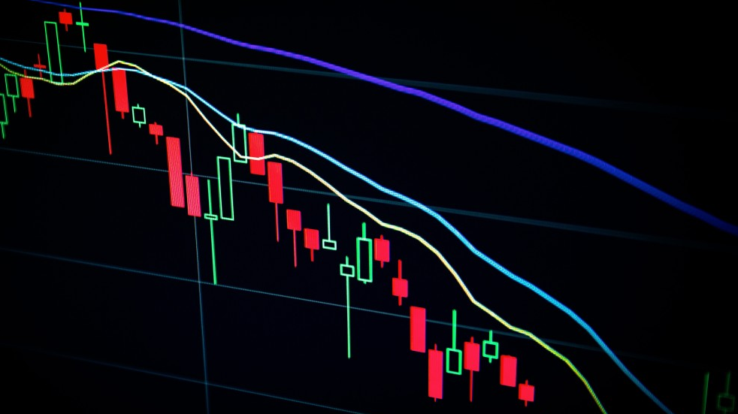
Signature Transforms for Stock Movement Prediction
Group G, Capstone Team 167

Slide 2
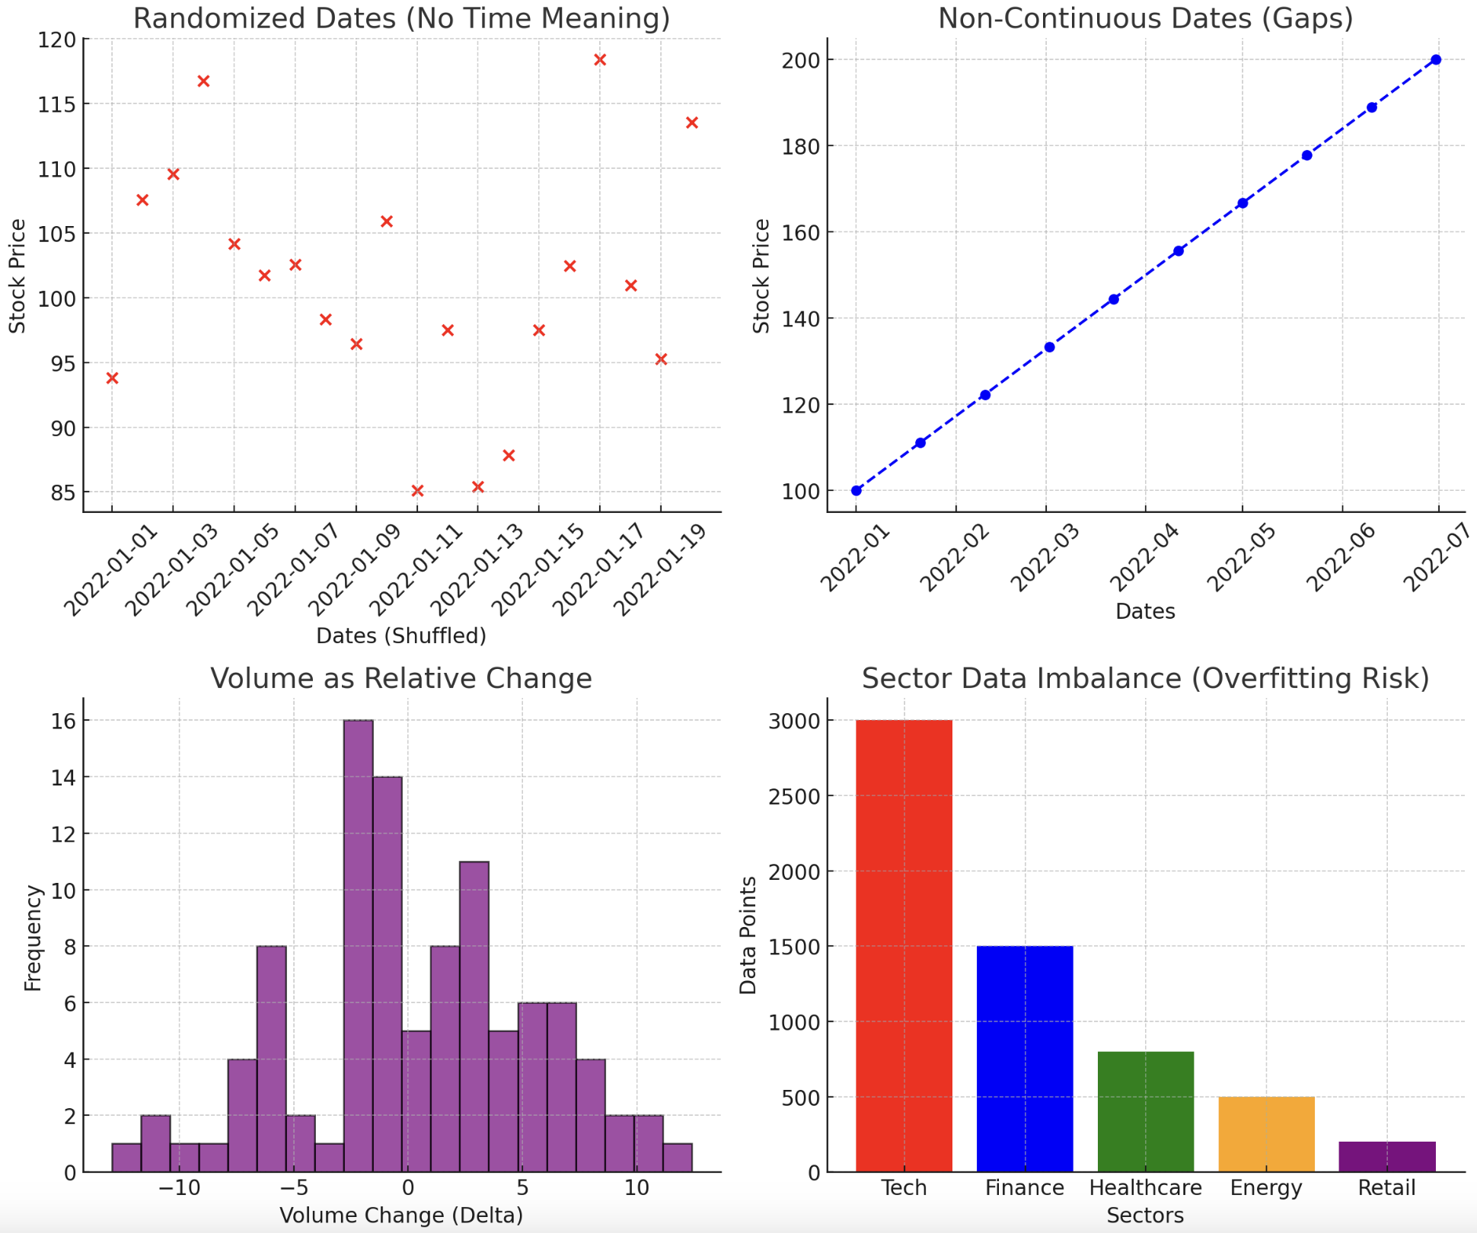
Data Challenge: Randomization of Dates
Challenge:
Dates randomized/anonymized (no continuity)
20-day snapshots for each stock
Impact:
Computed Signatures may not truly represent evolving patterns over time, limiting the performance of models

Slide 3
Data Challenge: Relative Volume
Challenge:
Ratio relative to average trading volume
Represents a "delta" or change metric
Impact:
More sensitive sensitive to short-term market events, introducing volatility and noise.
Signature methods may amplify this noise, mistaking random fluctuations for meaningful interactions.

Slide 4
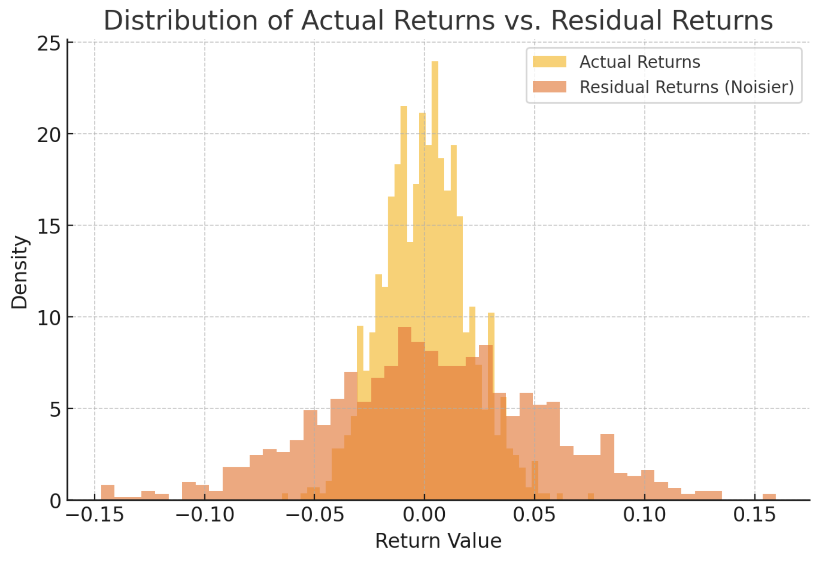
Data Challenge: Residual Returns
Challenge:
Portion of stock return that cannot be explained by a benchmark model (like systematic risk factors)
(Actual Return – Expected Return)
Represent everything left over (stock specific events, liquidity shocks, random fluctuations)
Impact:
Volatile and noisy, making it harder to learn stable patterns. Very sensitive to short term movements, hard to predict when combined with the 20 day windows.

Slide 5
Data Challenge: Sector / Industry Imbalance
Challenge:
- Certain industries dominate
Training v Testing:
underrepresented sectors in training become prominent in testing
Impact:
Models struggle to learn reliable sector-specific patterns, causing large performance gaps when predicting unseen or underrepresented sectors.

Slide 6
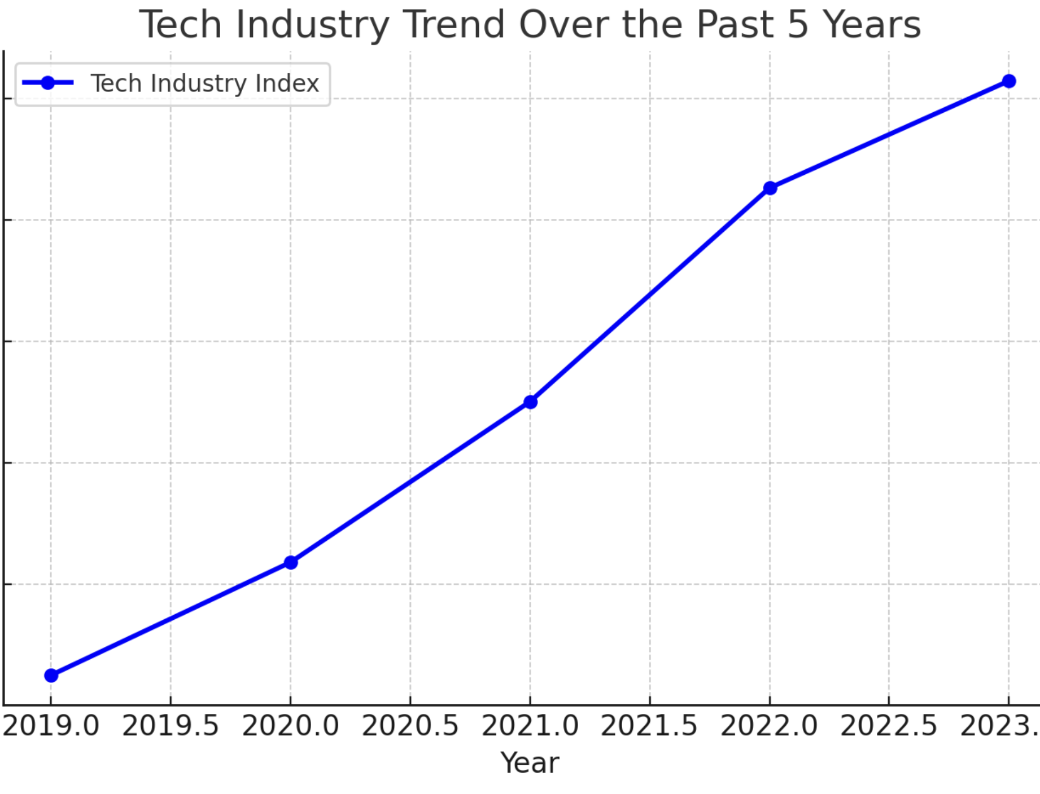
Data Challenge: Unidentified Labels
Challenge:
Industry classifications not explicitly identified
Impact:
- Models cannot leverage industry-specific contextual insight
- Significantly constrains the ability to interpret or contextualize results

Slide 7
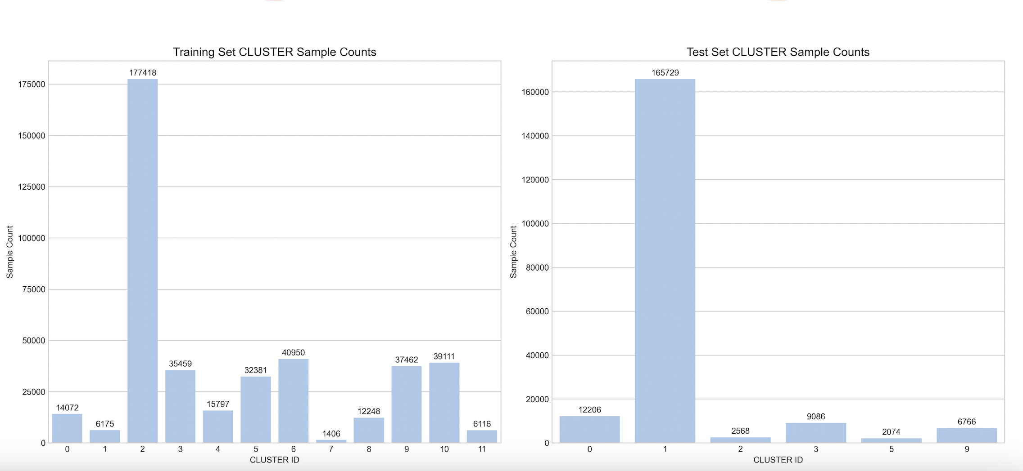
Data Challenge: Training vs Test
Challenge:
- Stock Composition Mismatch: ~300 unique stocks appear only in testing set
- Data Distribution Difference:
- Train: (0,3,6,…); Test (1,2,4,5,…)
Impact:
Scale Mismatch: train distances ~100s, test distances ~10s
test samples collapse into one group
Clusters due to date distribution and stock compositions

Slide 8
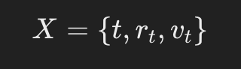
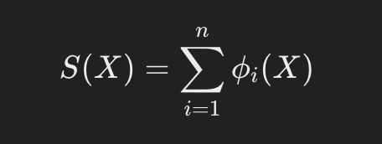
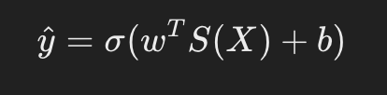
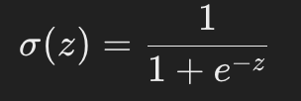
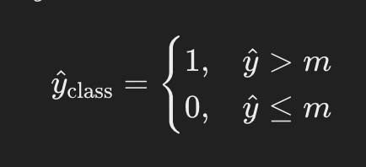
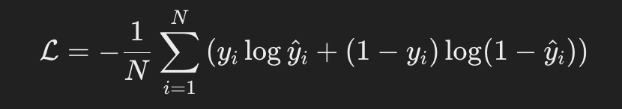
Logistic Regression
Time, return, volume
Apply signature transformation
Logistic Regression
Compute median/classify
Log Loss

Slide 9
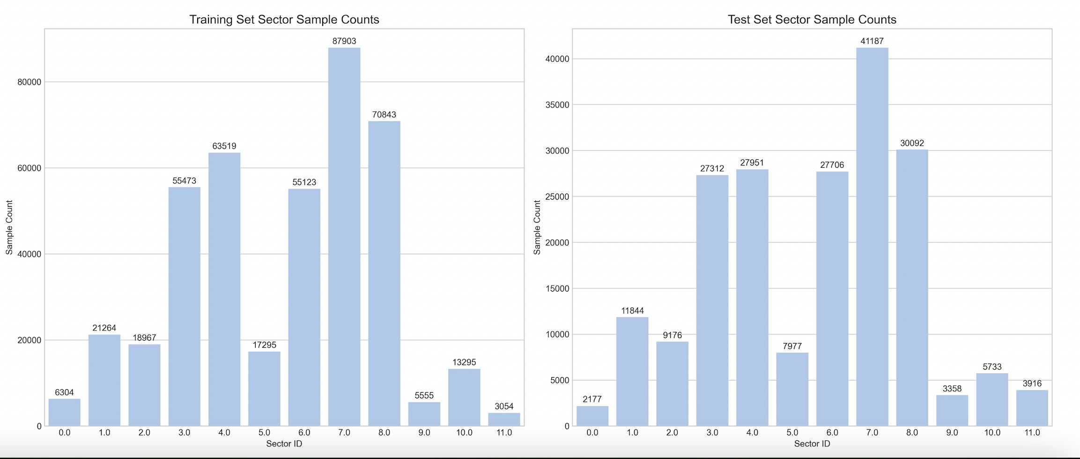
Logistic Regression (given groups)
General Training performing very well but testing is poor
Hypothesis: Data Imbalance in sectors/industries
Created models for each group
Similarly distributed between training and testing
Prediction accuracy still around baseline
Data problem, not modeling issue
Create new, automated groups within sectors

Slide 10
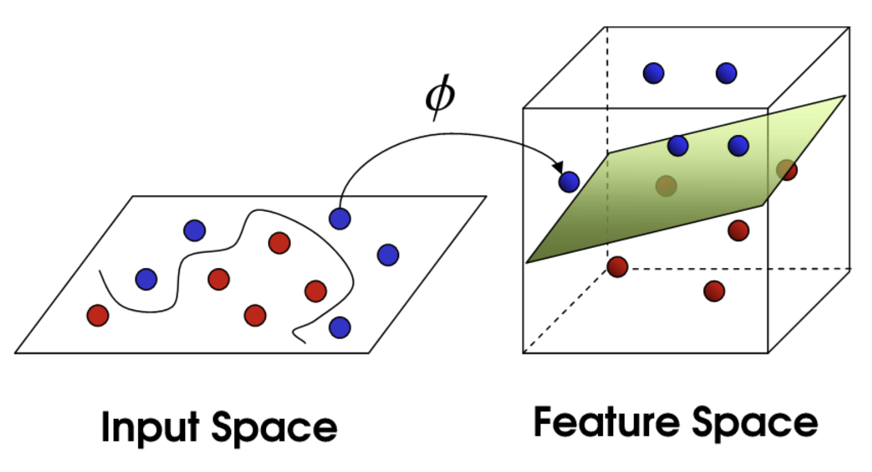
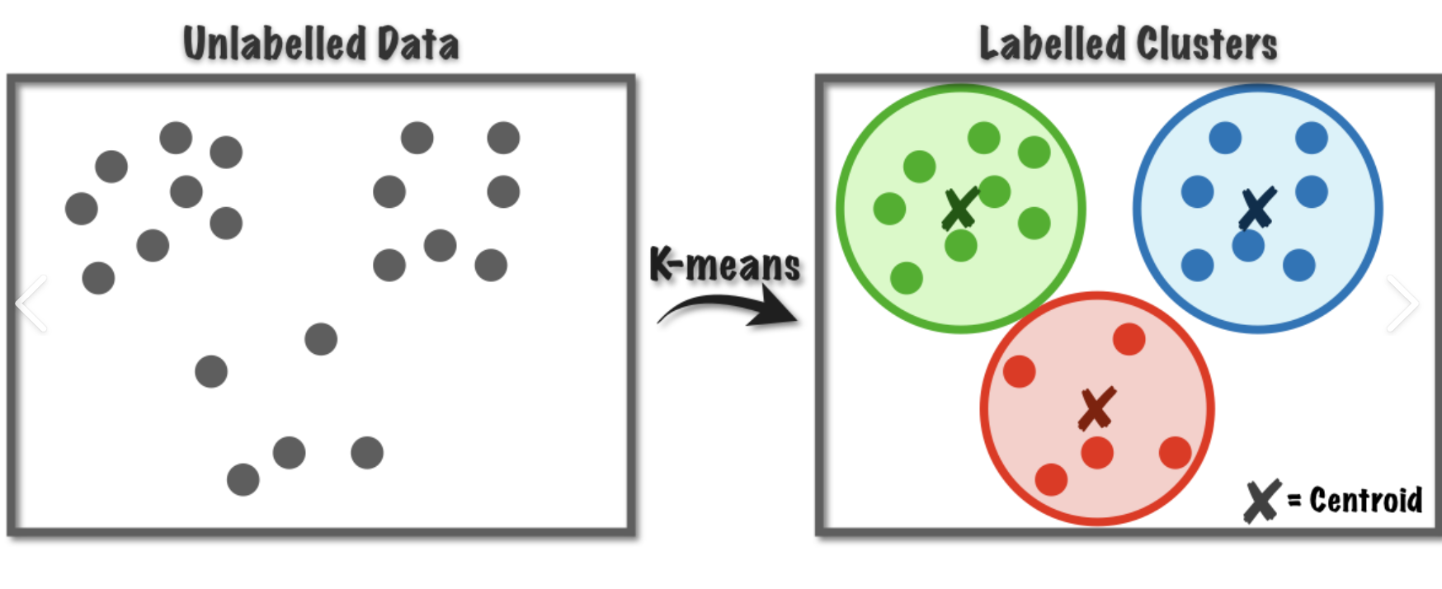
Logistic Regression w/ KMeans and Signature Kernels
Group stocks dynamically using KMeans
Signature Kernels as measure of similarity in a high dimensional space (use this as our distance)

Slide 11
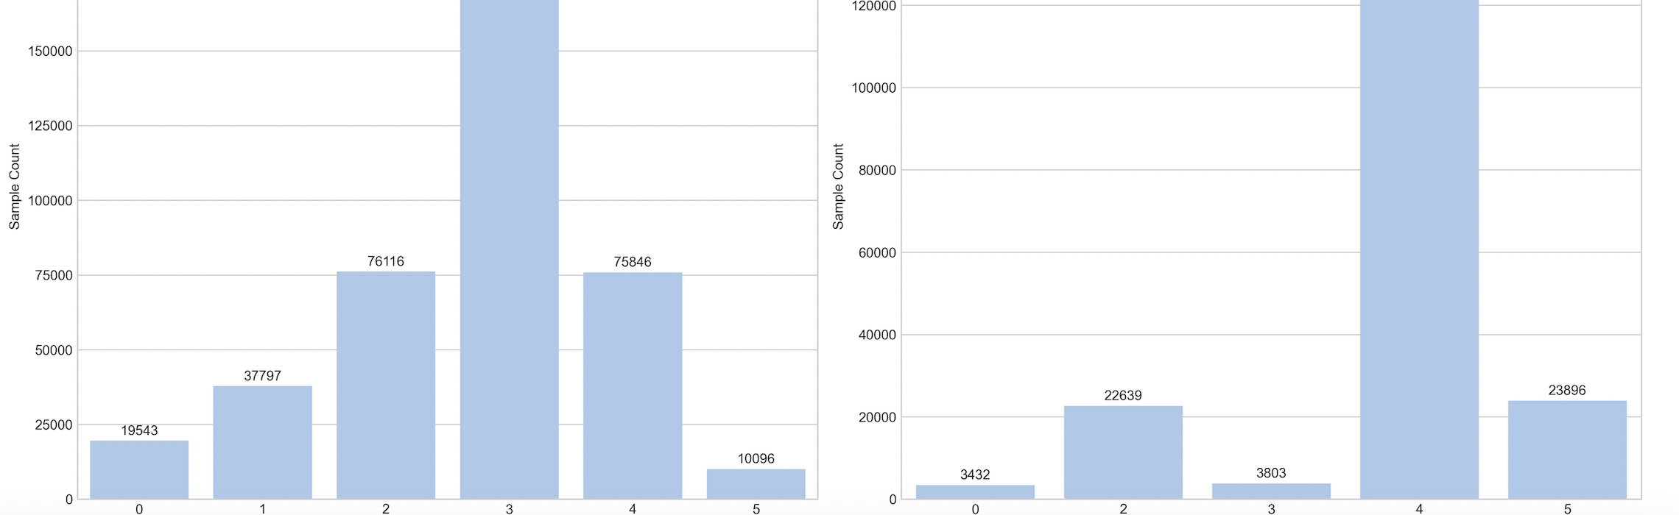
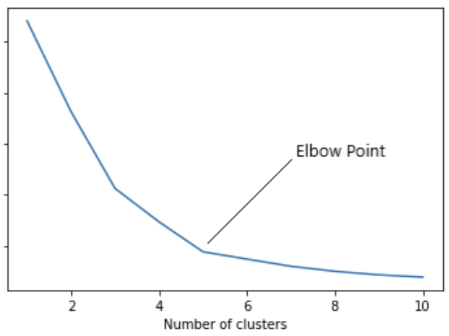
Logistic Regression w/ KMeans and Signature Kernels
- Using optimal number of groups
Large discrepancy in clustered data between train and test
Scale Mismatch: train distances ~100s, test distances ~10s
test samples collapse into one group

